Slide 1

[Samsung PRISM] End Review Report
(Vision) System Timestamp Recognition
Working Team Details [Name & Email ID] :
College Professor(s): Dr. Kayarvizhy N, Antara Roy Chaudhury, Rekha G S
Students:
Ankith S
Ashish C Harakuni
Bhargav S Patil
Bhuvan Garla
Department: Computer Science and Engineering
Date: 5 Nov 2019

Slide 2
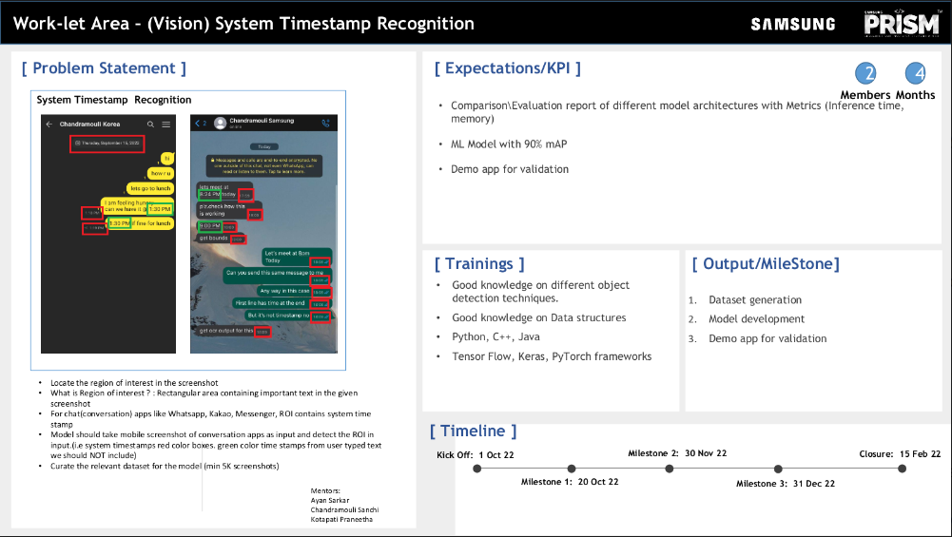
Notes:
-

Slide 3
Dataset(s) Analysis / Description
Dataset Capture / Preparation / Generation :
Screenshots have been collected by the team members with varying fonts, background color etc.
Interested regions have been annotated to generate the dataset.
So far the screenshots have been collected from WhatsApp, SMS, Kakao Talk, Line, Telegram, Discord, Viber, LinkedIn, FB Lite, Google Chats, Signal.
Number of screenshots collected from each app:
Whatsapp – 1740 Line – 250
Message – 670 Discord – 430
Instagram – 150 Signal – 60
Telegram – 550 Viber – 80
Kakao – 500 Swiggy – 20
FBLite – 230 Quora – 20
Payment Apps(GPay) – 100 Google Chats – 140
LinkedIn- 60 Snapchat - 20
Dataset Understanding / Analysis :
Datasets are chat screenshots.
In the dataset we have classified system datetime and user time.
Interested region is system date and time.
Dataset Pre-Processing / Related Challenges (if any) :
Collecting dataset from the apps which are not usually used.
Annotating the large dataset.

Slide 4
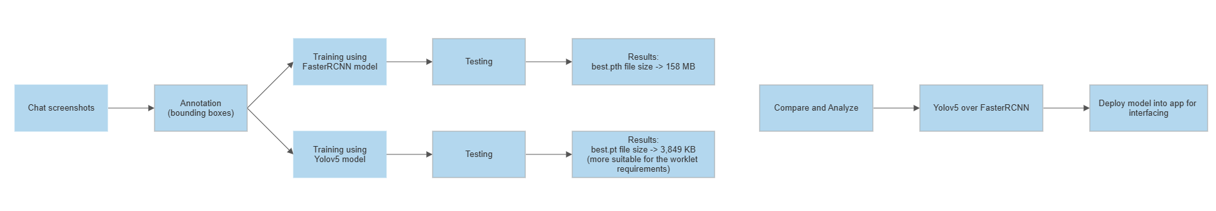
Approach / Solution
Concept Diagram :
Fig-1: Concept Diagram of the worklet

Slide 5
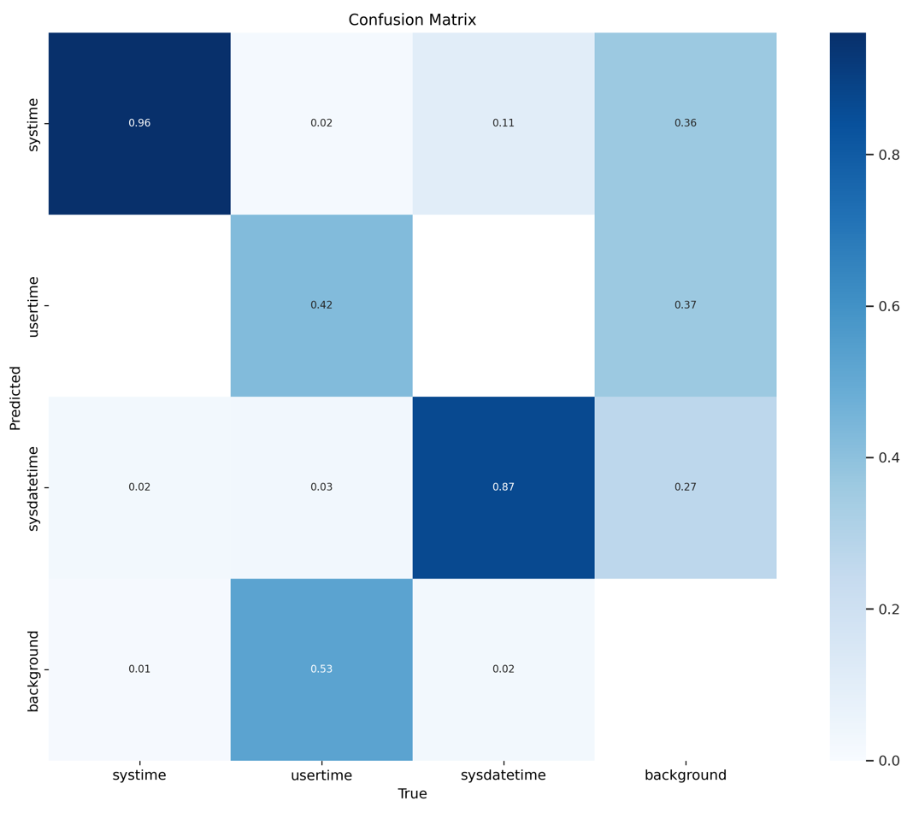
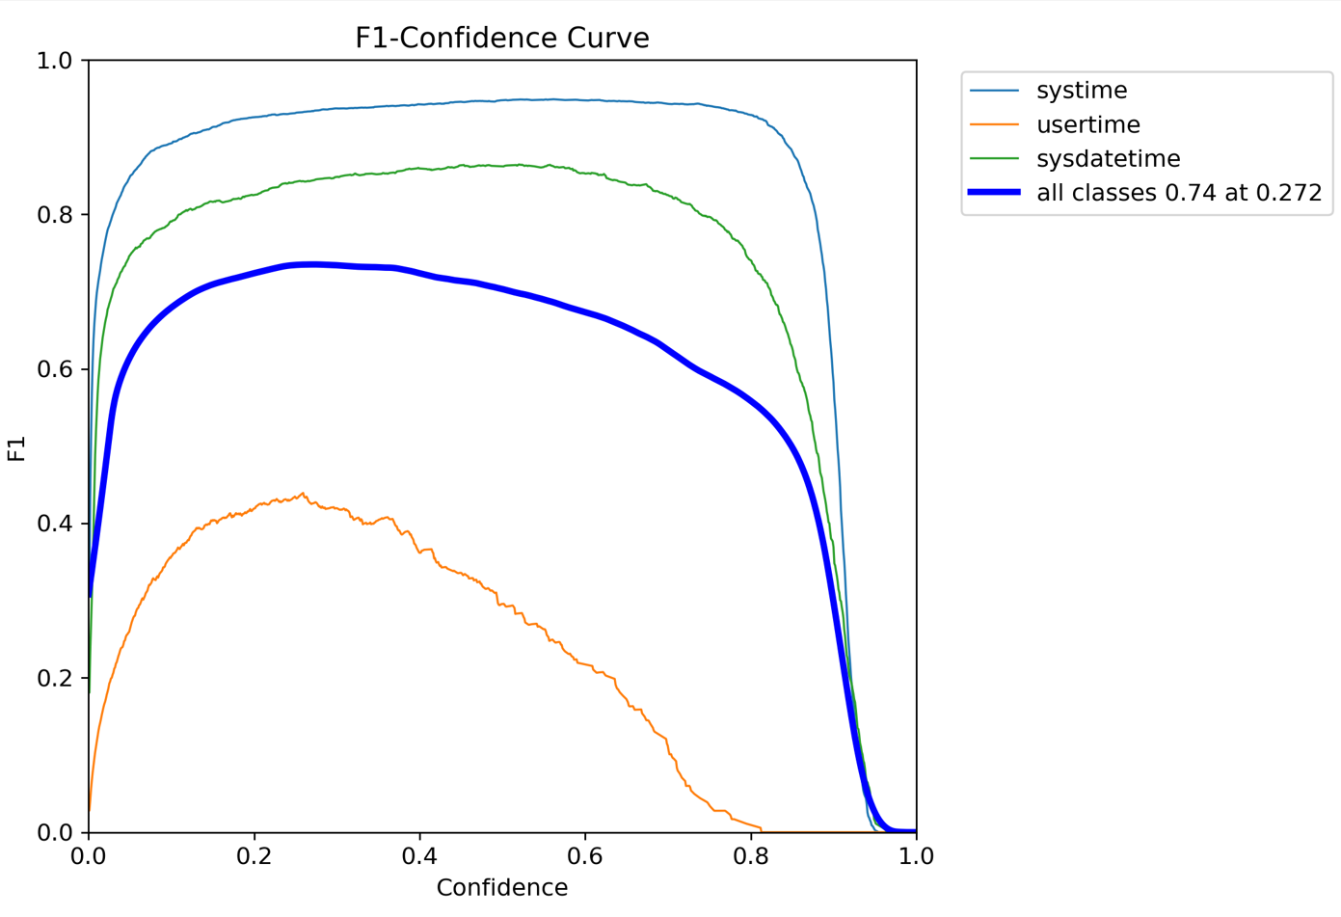
Experimental Results / Simulations / Observations
Results :
Fig-2: Confusion matrix for the three classes in our model
Fig-3: F1-Confidence curve for the three classes in our model

Slide 6
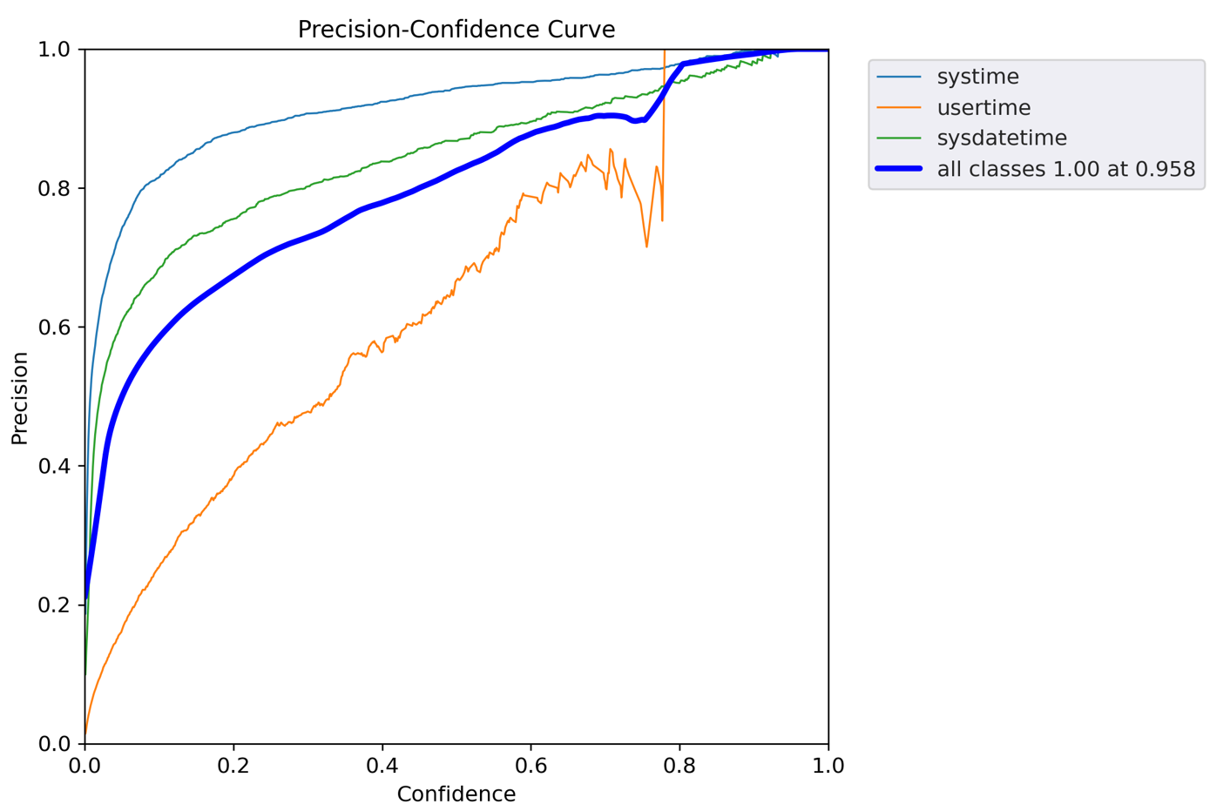
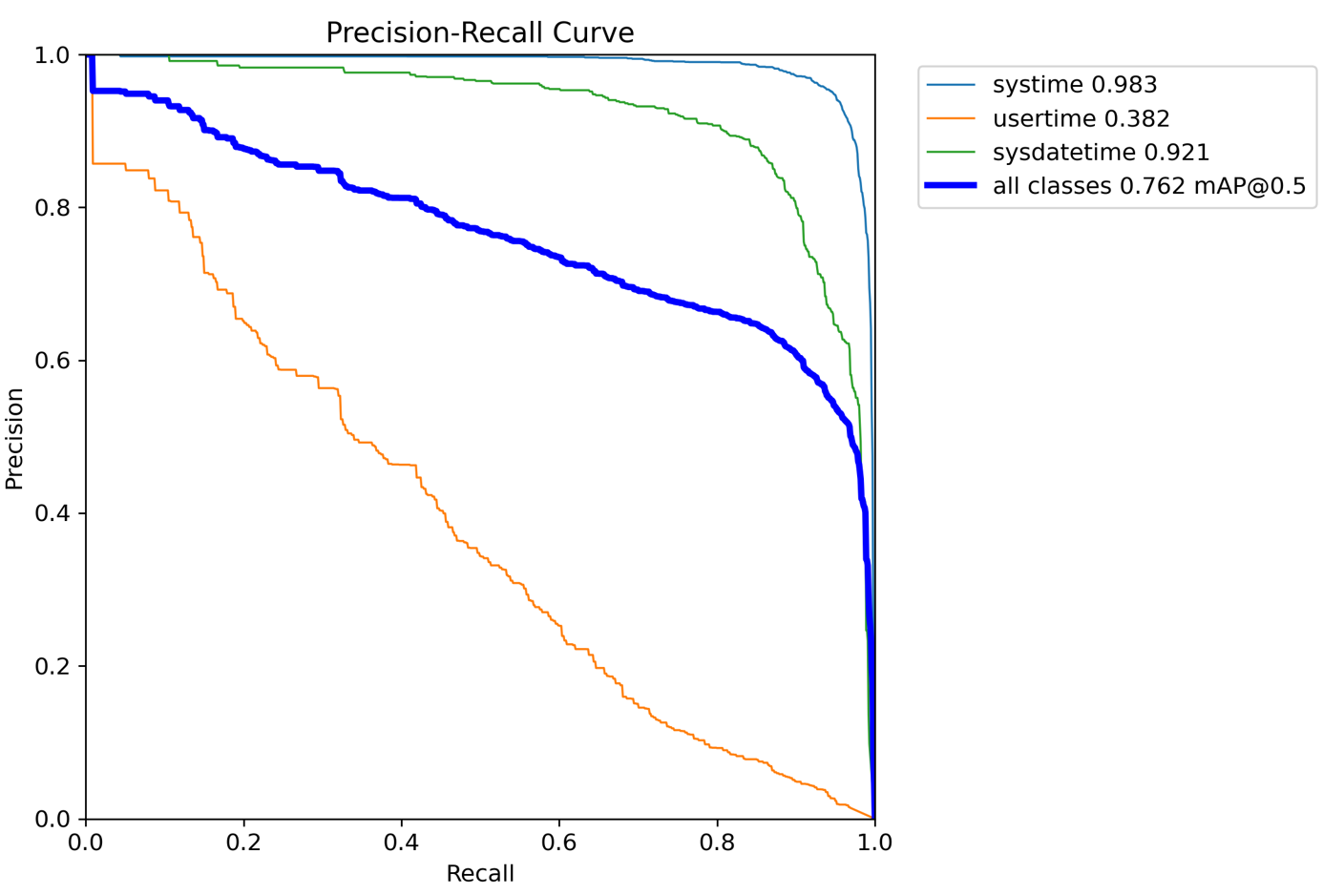
Experimental Results / Simulations / Observations
Results :
Fig-4: Precision vs confidence curve
Fig-5: Precision vs recall curve

Slide 7
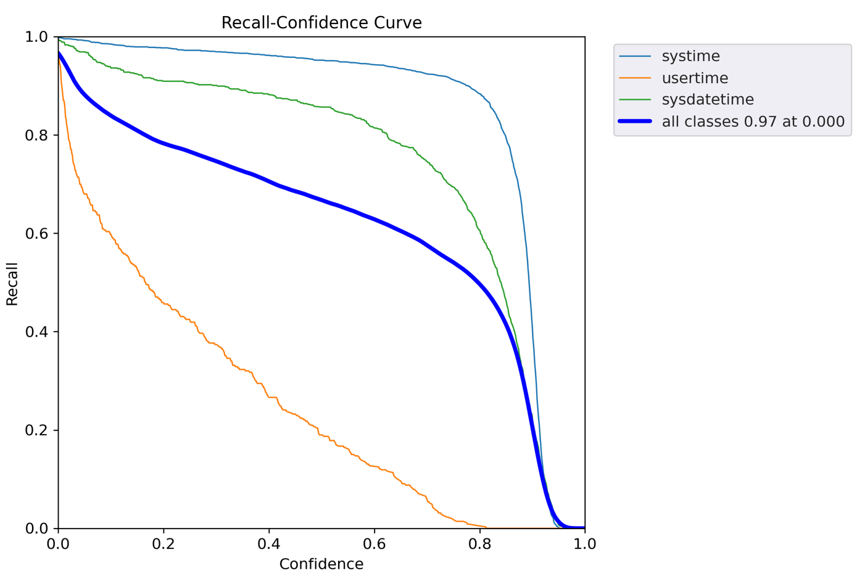
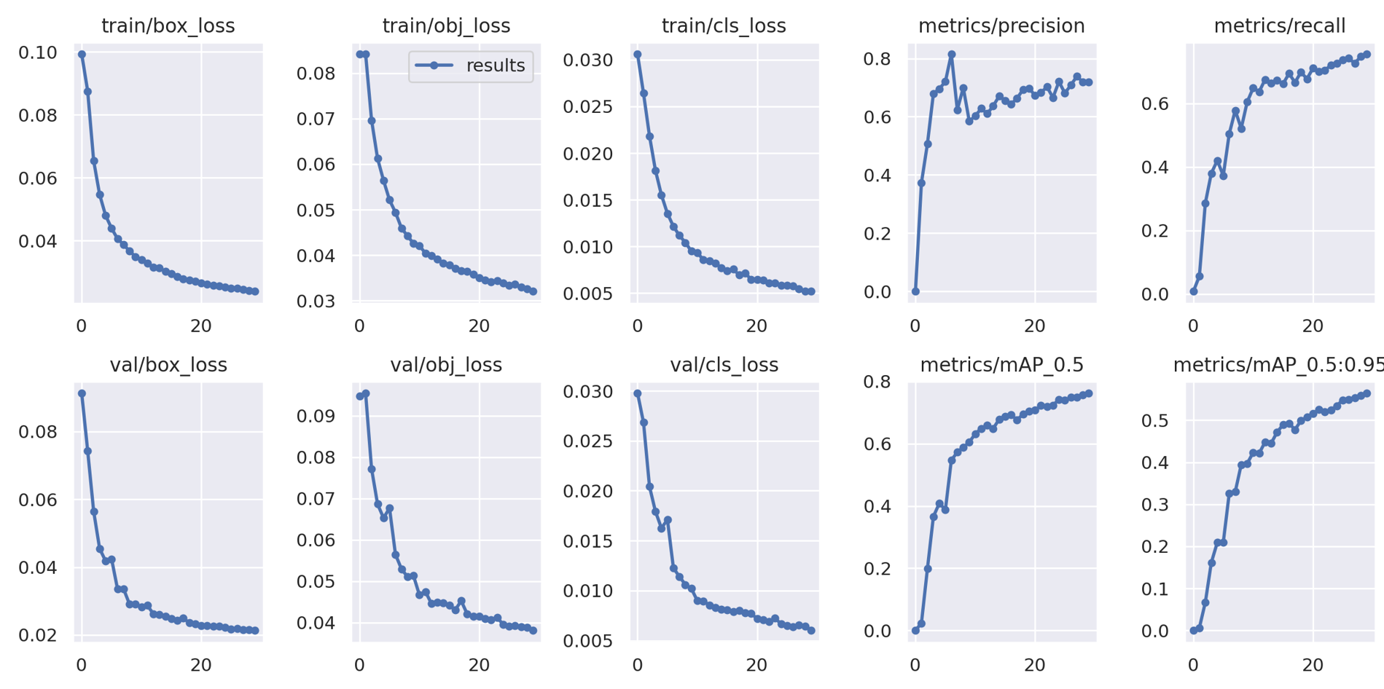
Experimental Results / Simulations
Results :
Fig-6: Recall vs confidence curve
Fig-7: Loss functions

Slide 8
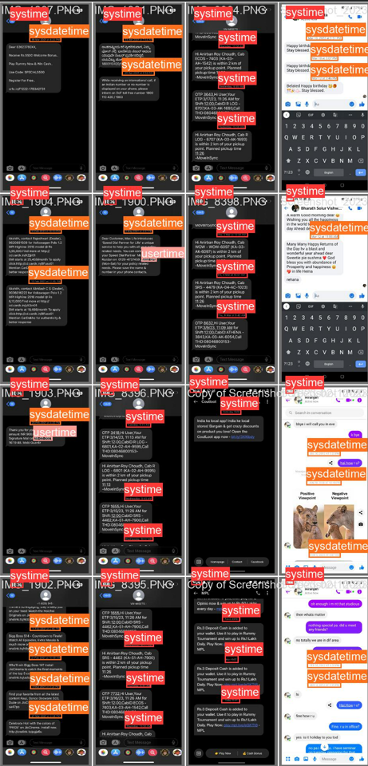
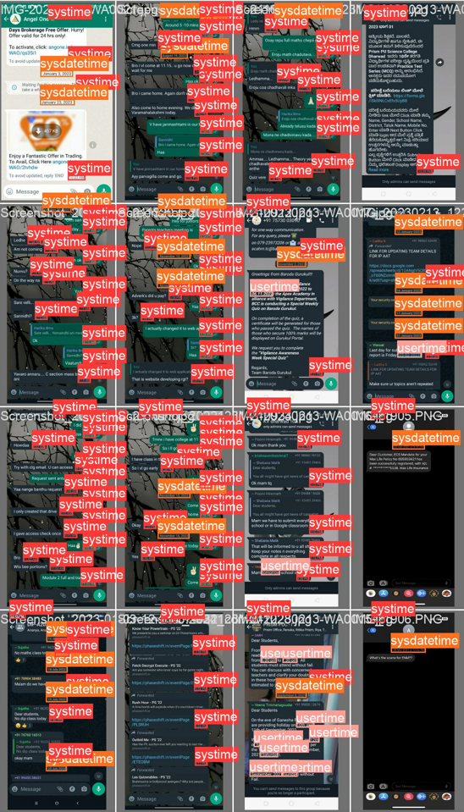
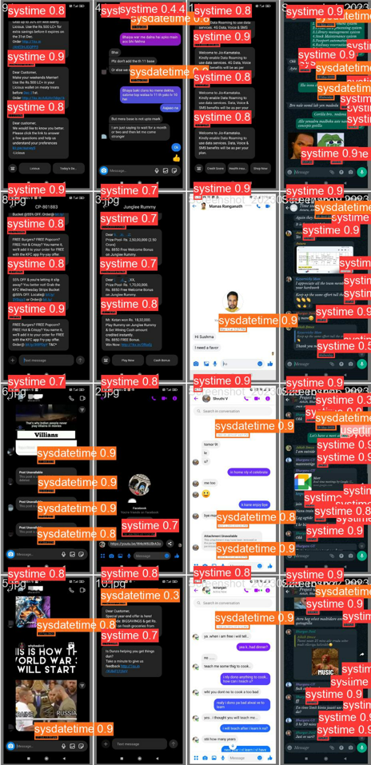
Experimental Results
Fig-8: Test Results

Slide 9
Experimental Observations
Major Observations / Conclusions & Challenges :
Observations:
The trained model is giving above 90% accuracy for system time and system datetime.
Size of best.pt file: 3,849 KB.
Size of best-int8.tflite: 1,971 KB. (to be deployed in app)
Challenges:
Unable to use local GPU due to versions incompatibility issues and other reasons.
Inferencing from the deployed TfLite model in android app.

Slide 10
Deliverable
Final Deliverables :
Yolov5n model
5k Chat screenshots
App for inferencing the model
Bottlenecks:
Not able to train 5k dataset using local GPU.
Facing issues in generating bounding boxes for test images in android app.
IP / Paper Publication Plan :
We are currently working on research paper.
Will be ready within a month
KPIs delivered/Expectations Met:
Trained and evaluated the dataset with different model architectures.
Collected 5k chat screenshots.
ML model with accuracy more than 90%.

Slide 11
Work-let Closure Details
Code Upload details:
Items | Details
KLOC (Number OF Lines of codes in 000’s) | 10
Model and Algorithm details | Yolov5n model for training. Converted pytorch weights to tflite weights for deployment in android.
Is Mid review, end review report uploaded on Git ? | Yes
Link for Git | https://github.ecodesamsung.com/SRIB-PRISM/BMSCE_OD212BMS_Vision_System_Timestamp_Recognition
Data details (if applicable):
Items | Data folder 1
Name & Type of Data (Audio/Image/Video) | Chat screenshots Type: Image
Number of data points | Collected 5K images from various chatting apps
Source of Data (self collected, Scrapped, available on open source) | Self Collected
Google drive link/ git link to access data | https://drive.google.com/file/d/1addCbxcU0DZ6uZrRs5RljF2Sqr3mz-3w/view?usp=sharing
Note: If data uploaded on google drive, access to be shared to prism.srib@gmail.com

Slide 12
Thank you

